Slide 1



Virtual Try On System
Outify
BY
AISWARYA SGI
JANANY J
(KGISL INSTITUTE OF TECHNOLOGY)

Slide 2

AGENDA
PROBLEM STATEMENT
EXISITING SOLUTION
PROPOSED SOLUTION
FLOWCHART
TECHNOLOGICAL STACK
REVENUE MODEL
CONCLUSION

Slide 3
PROBLEM STATEMENT
Uncertainty in Online Shopping: Difficulty in visualizing fit and appearance.
High Return Rates: Increased due to inaccurate expectations.
Customer Dissatisfaction: Resulting from unmet expectations.
Environmental & Financial Impacts: Negative effects on both consumers and retailers.
Need for a Solution: Enhance the shopping experience and reduce returns.

Slide 4

EXISTING SOLUTION
The Virtual Try-On System makes online shopping more fun and worry-free by letting you see how clothes, accessories, or makeup look on you before you buy.
With features that let you to capture your own photo, and recommends similar items.
Example - H&M (Dressing store)

Slide 5

APPROACH
User Extraction: Capture video and estimate the user's pose identifying key body points for accurate alignment using OpenCV.
Human segmentation: Using U-net to separate the user's body from the background accurately. This allows for precise superimposition into a virtual environment.
Superimposition: Place the isolated user into a virtual scene for immersive interaction.
Real-Time Interaction: Track user movements to ensure seamless integration into the virtual environment.
Interface Integration: Combine the virtual scene and user in an intuitive interface for natural interaction.

Slide 6
PROPOSED SOLUTION
Users can even personalize their experience by choosing different models or uploading their own photos.
This system also connects with online stores, making it easy to purchase items directly.
The main goal is to tackle the common issues of uncertainty and high return rates in online shopping.

Slide 7
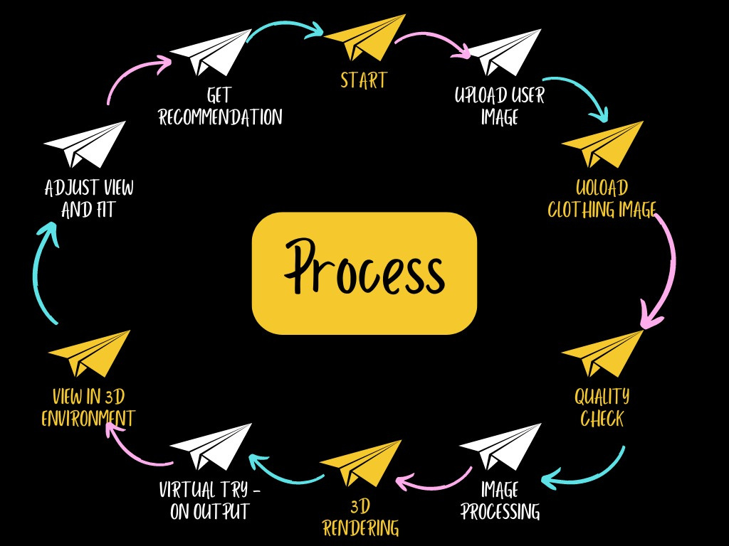
FLOWCHART

Slide 8
TECHNOLOGICAL STACK
React, React Native
Figma - UI
Opencv or TensorFlow
Python
MySQL or PostgreSQL
MongoDB
Django

Slide 9

REVENUE MODEL
TAM (TOTAL ADDRESSABLE MARKET)
Market Size: $120 billion (Asia represents roughly 40% of the global online apparel market, with a similar 30% return rate)
Revenue Potential: If we captured the entire TAM in Asia, our system could potentially save up to $30 billion annually for retailers by reducing return rates by 25%.

Slide 10
REVENUE MODEL
SAM (SERVICEABLE AVAILABLE MARKET)
Market Size: $60 billion (Focusing on major e-commerce markets in Asia such as China, India, and Japan, which make up about 50% of the TAM in Asia)
Revenue Potential: By capturing this market and reducing return rates, we could save retailers up to $15 billion annually.

Slide 11
REVENUE MODEL
SOM (SERVICEABLE OBTAINABLE MARKET)
Market Size: $600 million (Targeting 1% of the SAM in the first three years)
Revenue Potential:
Year 1: $7.2 million in revenue.
Year 2: $18 million in revenue.
Year 3: $30 million in revenue.

Slide 12
USE CASES
Enhancing In-Store Experience - Compare outfits quickly
Inventory Management and Optimization - Real Time Stock Updates
Data Driven Marketing and Customer Insights - Reduce returns, Save preferences across channels.
Accessibility and Inclusivity

Slide 13




SAMPLE INPUT DATA
TRAINING IMAGES
MASK IMAGES

Slide 14
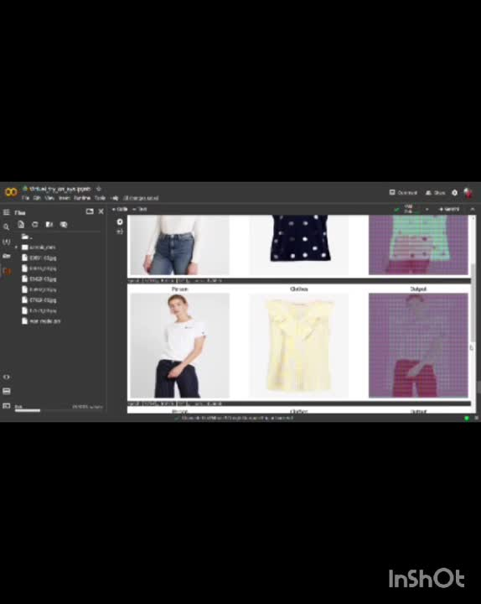
SUPPORT MATERIALS

Slide 15
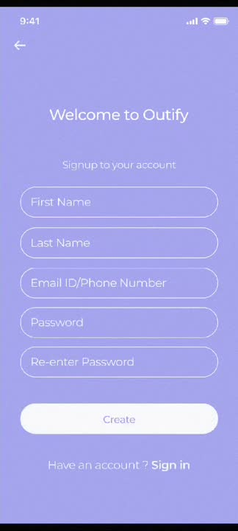

SUPPORT
MATERIALS
Take a look at it

Slide 16
CONCLUSION
Realistic and Interactive Experience: The Virtual Try-On System offers a lifelike way to try on clothes online.
Advanced Image Processing & 3D Rendering: Ensures accurate and appealing virtual try-ons.
Enhanced Personalization & Reduced Returns: Increases user satisfaction and merges physical and online shopping benefits.

Slide 17



THANK
YOU
aiswaryasgi23@gmail.com
jananyj22@gmail.com

